Slide 1
Company Growth
Jose Reyes and Jarom Asher

Slide 2
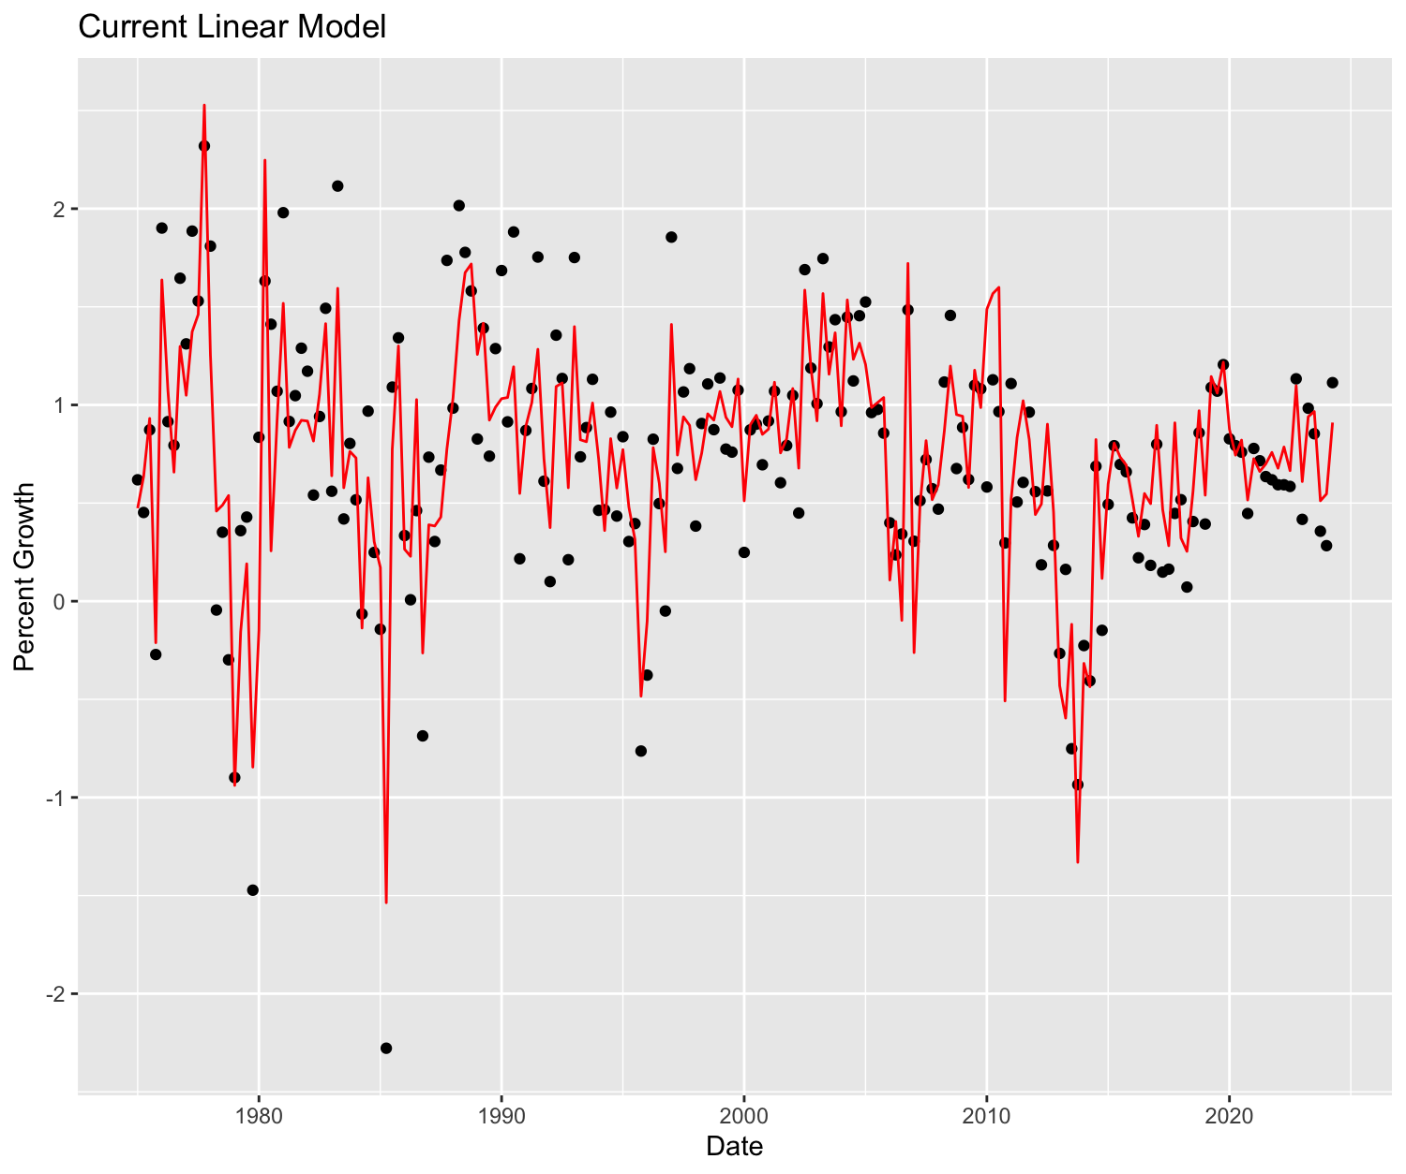
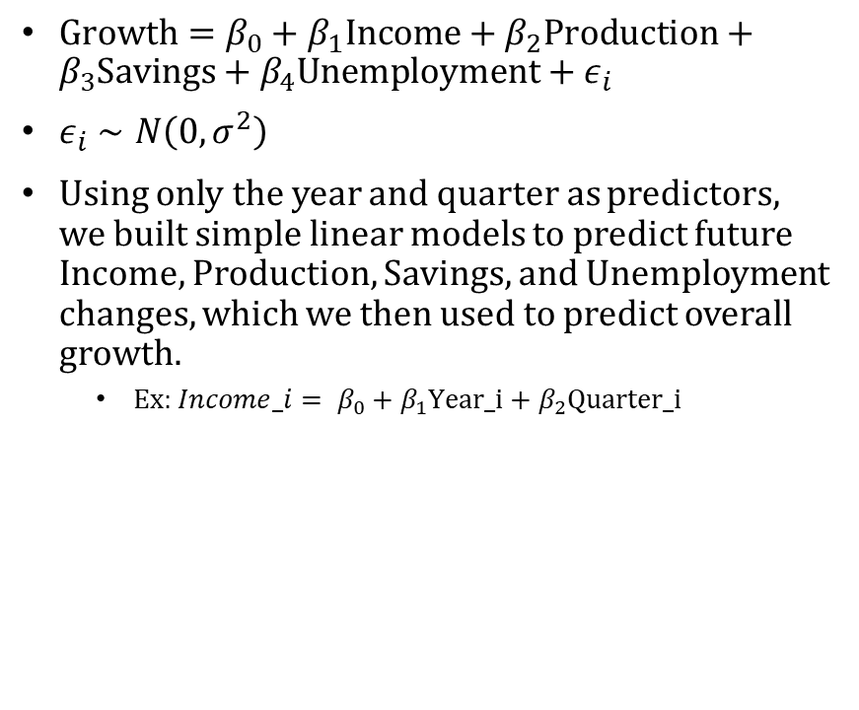
Current Model
$\text{Growth}=β_{0}+β_{1}\text{Income}+β_{2}\text{Production}+β_{3}\text{Savings}+β_{4}\text{Unemployment}+ε_{i}$
$ε_{i}∼N\left(0,σ^{2}\right)$
Using only the year and quarter as predictors, we built simple linear models to predict future Income, Production, Savings, and Unemployment changes, which we then used to predict overall growth.
Ex: ${Income_i= β}_{0}+β_{1}\text{Year}\text{_}\text{i}+β_{2}\text{Quarter}\text{_}\text{i}$

Slide 3
Model Performance and Estimates
To test model performance, we split the data and used 1975-2014 data to predict 2015-2024 values which could then be used to predict growth.
We found that this basic linear model gave us an error, or rmse, of 0.3157
You’ll see in our future models that we can do much better than this.
Using all our data (1975-2024), we found the following predictions for each 2025 quarter
Q1: 0.6224
Q2: 0.6521
Q3: 0.6818
Q4: 0.7115
These values seem pretty on par for growth rates we’ve seen in the past.

Slide 4
Feature Engineered Linear Model
We decided to create some extra features in our model that account for:
Year
Month
Day of Week
Quarter
These take our linear model to a new level by accounting for patterns and trends in collected data to paint a more detailed picture of the future

Slide 5
ARIMA model
ARIMA models are powerful tools for predicting
Unlike our basic linear model, ARIMA models use more than just past observations to predict
This model uses how past observations correlate with each other (lags) to capture patterns in the data
It also utilizes past predictive errors to adjust predictions
These adjustments lead to more precise estimates and generally more accurate predictions

Slide 6
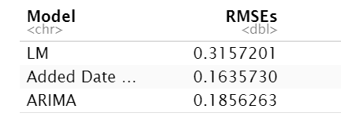
Ability to Predict
To get the following prediction estimates, we trained each model based on 1975-2014 data and fit 2015-2024 data, then compared our estimates to the actual company growth percentages.
After fitting these models, we found that both new models predict much better than our original linear model.

Slide 7
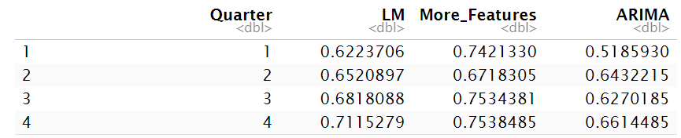
2025 Predictions
We then retrained them on the entirety of the data, predicting Income, Production, Savings, and Unemployment changes and using those predictions to predict company growth in 2025
The predictions are as follows :

Slide 8
Variable Importance
While our feature engineered and ARIMA models tend to predict better to future data, we believe that the basic linear model can still give us an accurate idea of how Income, Production, Savings, and Unemployment changes affect company growth
It is also more easily interpretable, so we decided to use this model to evaluate this effect

Slide 9
Variable Importance
Based on p-values, we found that Income and Savings were the greatest predictors of company growth (p-values: essentially 0).
Production and Unemployment appear to be much less influential, but can very well effect it too (p-values: 0.0429, 0.0689 respectively)
That being said, we will discuss the influence of each

Slide 10
Variable Importance
Income: As our macroeconomic income indicator increases by 1 unit, company growth increases by between 18.5% and 32.1% on average.
Production: As our macroeconomic production indicator increases by 1 unit, company growth increases by between 0.2% and 9.3% on average.
Savings: As our macroeconomic savings indicator increases by 1 unit, company growth decreases by between 4.7% and 5.9% on average.
Unemployment: As our macroeconomic unemployment indicator increases by 1 unit, company growth decreases by between 1.4% and 36.3% on average.

